Slide 1
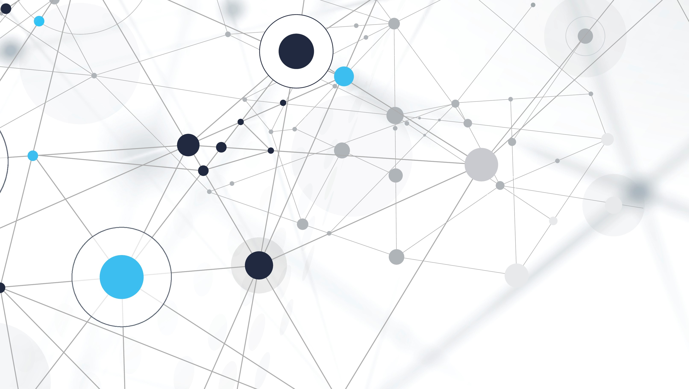
Introduction to LLM
Sahith R Shetty Platform Engineer – Automation and AIOps https://www.linkedin.com/in/sahith-r-shetty-1bb831185/

Slide 2
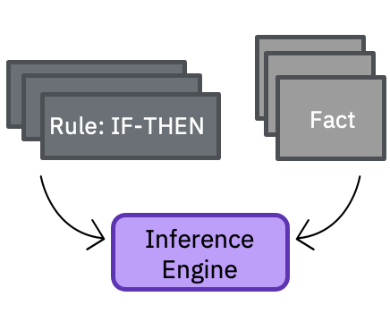
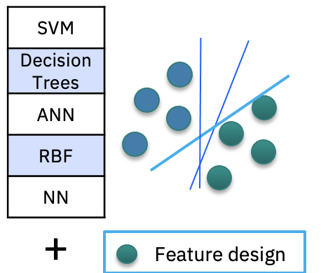
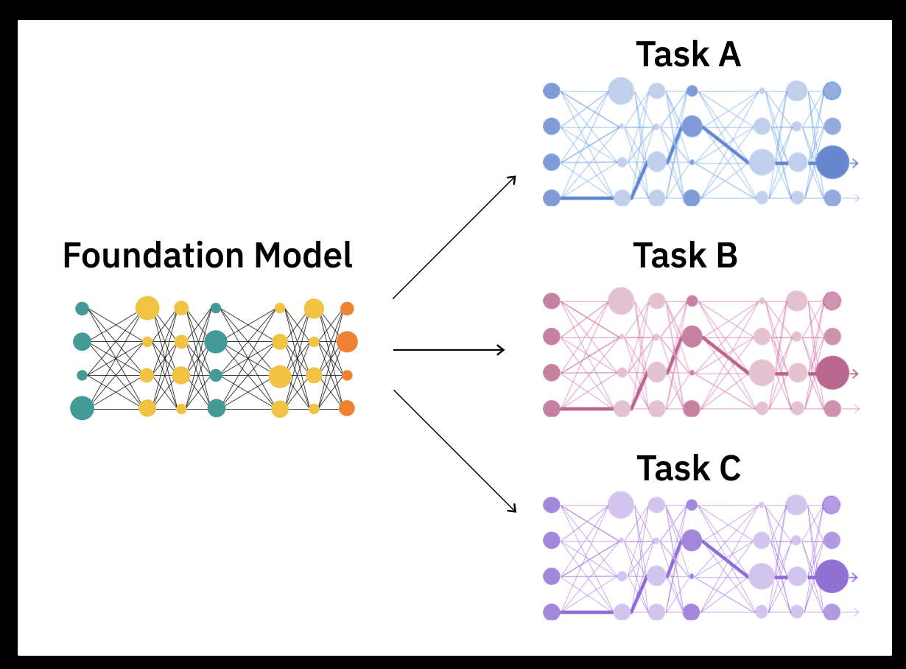
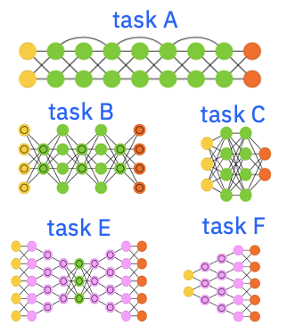
The story of AI is a story of data representations
1980s
Big data
1980s to ~2010s
Massive labeled data + Compute
2017+
Self-supervision at scale
+
Massive unlabeled data + Compute
Expert systems
Rule engines
Machine learning
ML algorithms
Task-specific decision boundaries
Deep learning
Network architectures
Task-specific decision boundaries + feature representations
Foundation models
Base model
Adaptable decision boundaries and feature representations
Notes:
Generative AI represents the latest innovation in the long history of the artificial intelligence (AI) journey on data representations. It began with expert systems and early inference engines in the 1980s using symbolic representations of data.
The modern era of AI and machine learning (ML) began in the 1980s and culminated in deep learning in the later part of the 2010s. These models required a massive amount of labeled data to train. The resulting models were targeted for specific tasks and while these models could be successful, they were expensive (finding and labelling sufficient data) and not easily transferrable to other tasks not initially thought about when model training began. Solving different tasks (even though they may be related) required another set of labeled data and retraining. Such task-specific learning models were not scalable and became expensive. This is analogous to training an intern to understand and interpret legal documents versus medical content. These industries have different vocabularies, ways of thinking, and ways to resolve gray areas, among other differences.
New ideas, innovation, and new techniques began to emerge in the late 2010s to provide the next leap in AI modelling – foundation models and generative AI. Unlike the traditional ML and AI models, foundation models are trained on massive but unlabeled data sets and use self-supervised learning. Foundation models have a much broader base (foundation). Today, Large Language Models (LLMs, a type of foundation model) have proven to be very useful, especially in initial applications for areas in natural language processing (NLP) tasks.

Slide 3

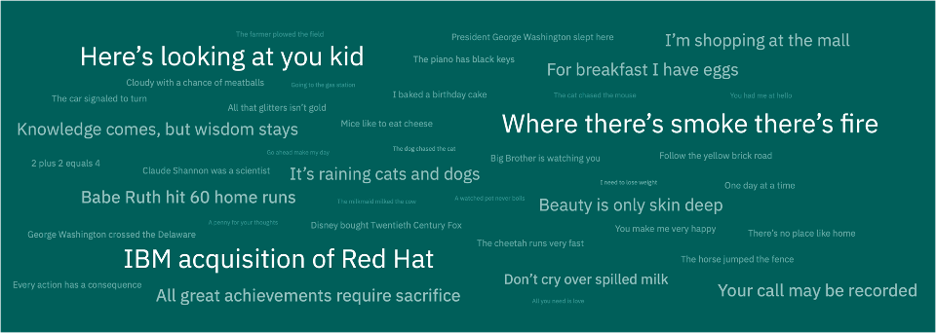
Foundation models are …
Pre-trained
On unlabeled datasets of different modalities (e.g., language, time-series, tabular)
Self-learning
Systems that leverage self-supervised learning
Self-supervised
training
Multiple applications
Able to learn generalizable and adaptable data representations that can be effectively used in a variety of domains and tasks (code generation, question answering, sentiment analysis)
Large language models
A type of foundation model trained withy language-related data
ChatGPT is based on a large language model
Foundation model
Notes:
Why are foundation models so powerful? At a high level
Foundation models are pre-trained. Unlike other machine learning (ML) models that clients will have to train (providing labeled data, working in an iterative process, monitoring, deploying, and maintaining), foundation models come pre-trained with huge and different unlabeled datasets. Clients can use them as is.
Foundation models can be further tuned with small sets of labeled data for downstream tasks for which they were not built for.
Foundation models are not specific to any tasks and can be used to apply to many tasks such as generating code snippets, answering questions from legal, medical, architectural, procedural, analyzing sentiments, and many more. Foundation models are quite good “as-is” and require much less additional data to provide additional refinements to better support specific tasks.
The most typical tasks today are natural language processing (NLP) tasks. The types of foundation models for these language-related tasks and data are called large language models (LLMs). Note that LLM is more than how humans communicate; for example, programming languages also fall into the domain of LLM. ChatGPT is based on a LLM.
The strength of foundation models is that they are generally quite capable (as is) and are easily adapted to perform specific tasks with a fraction of the training required to build a task-specific traditional AI model.

Slide 4
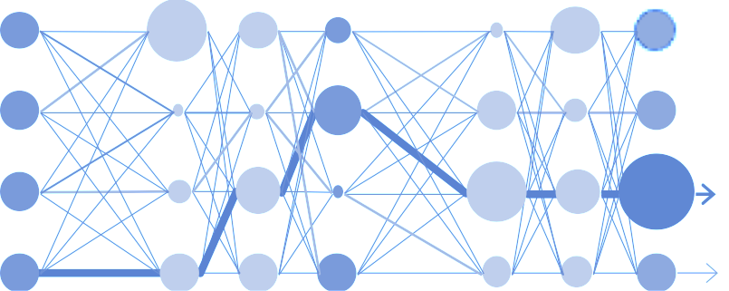



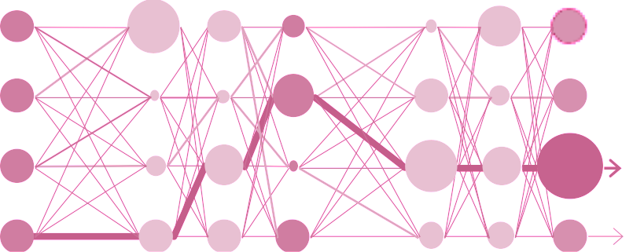

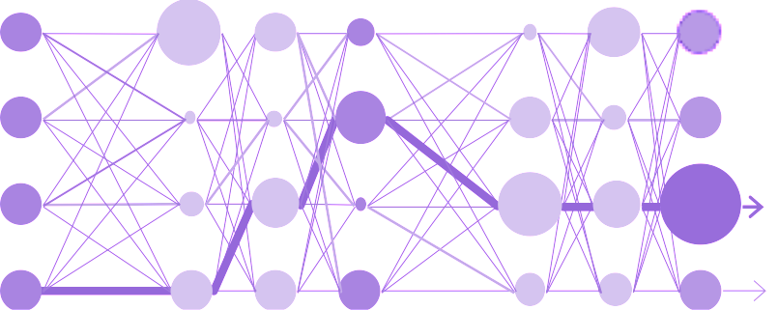

Foundation models: generalizable and adaptable
Translation
model
Task-specific
fine-tuning
+
Summarization
model
Answer finding
model
Notes:
Foundation models can easily be adapted to take over downstream tasks for which they were not originally built for using labeled data.
In the simplest form, a foundation model platform knows sufficient general knowledge to be able to generate meaningful responses to various tasks (translation, summarization, finding answers). Given a sufficiently large set of training data (without the expensive labeling), a foundation model can usually perform quite well at specific tasks. A foundation model platform provides a prompt mechanism where users can input some text and generate a response. The foundation model will take the input and generate the desired output.
Users can also provide task-specific fine-tuning (with data and input specific to the task). Foundation models can then be easily adapted to create the appropriate task model (for extraction, summarization, or to find answers to general questions). Foundation models require a small (much smaller than traditional AI) set of labeled data to fine-tune for specific tasks, and they can easily be adapted for many different tasks with much less effort than traditional AI.
Enterprise clients will likely want to adapt foundation models to their specific use. Successful vendors provide ease of fine-tuning for their foundation models.

Slide 5
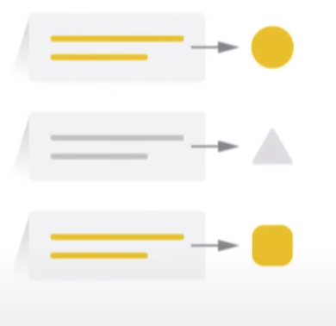



Large Language Models: Use-cases
Text Classification
Question Answering
Document Summarization
Text Generation

Slide 6
Large Language model: Reference Model
Ada Lovelace is …..
[23255, 23974, 295, 815, ….]
How it works
Text get Tokenized
Tokens get fed to model
Model Outputs Predicted Tokens
Output tokens converted to texts
Output Layer
LLM
Attention Layer
Embeddings Layer
[1, 11644, 338, 23255, 23974, 295, 815, 1577]
Who is Ada Lovelace ?
Notes:
The input text and output text are never seen by the model , it deals with embeddings. Basically tokenized representation of words Subword tokenization idea helps to keep vocabulary short ,
High vocab , larger the embedding vectors hence more memory and compute to run – obviously better results

Slide 7
Notes:
This self-explanatory slide does not require speaker notes.

